Slide 1
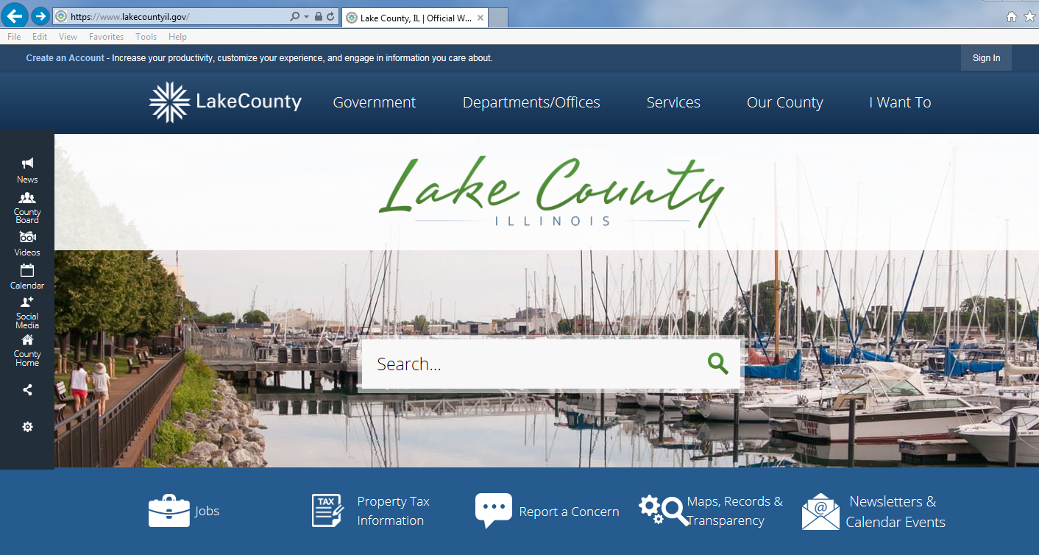
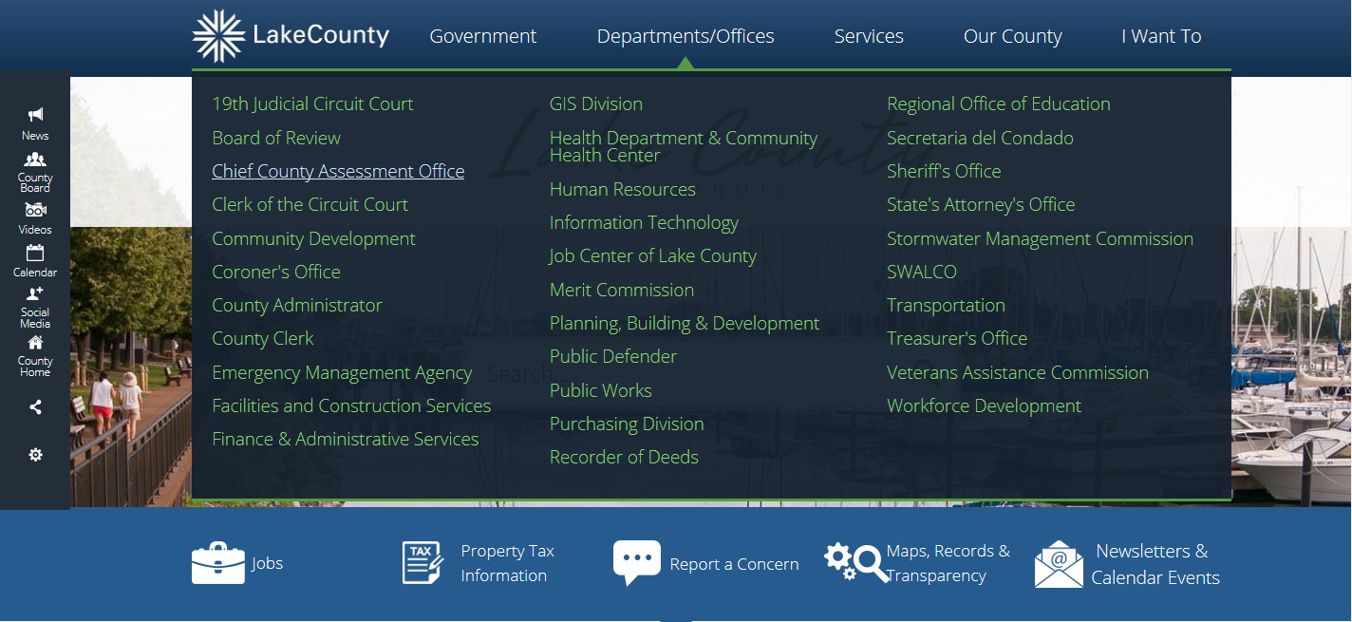
Senior Citizen Assessment Freeze Application Guide using the on-line Smartfile E-Filing Portal
JOE HERCHENBACH
Fremont Township Assessor
22385 W. IL Route 60
Mundelein, Illinois 60060
Phone: 847-223-2846
Email: Assessor@FremontTownship.com
Website
fremonttownship.com/departments/assessor
To Begin:
Go to www.lakecountyil.gov
Hover over Departments/Offices
Click on Chief County Assessment Office.
Required Documents:
Drivers License or State ID
2019 Federal Income Tax
*** For on-line filing you will need to have the ability to scan or take a picture of your drivers license and 2019 Federal Income Tax to upload.

Slide 2
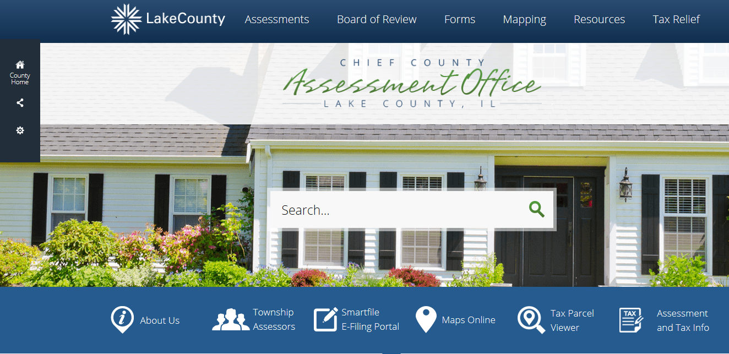
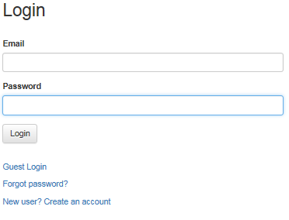
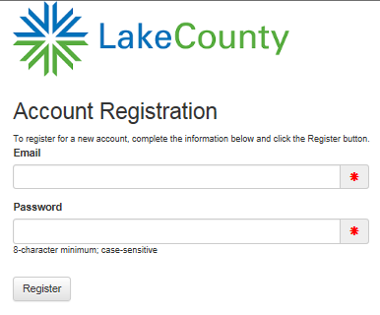
Click on the Smartfile, E-Filling Portal.
The Lake County Login page will open (below)
If you already have an account, enter your email and password then click LOGIN
*** New Account Set-Up ***
When creating a New User account you will need:
an active e-mail address
to create a password for your Lake County account.
Verify your new account via your e-mail
To create an account click on
New user? Create and account.

Slide 3
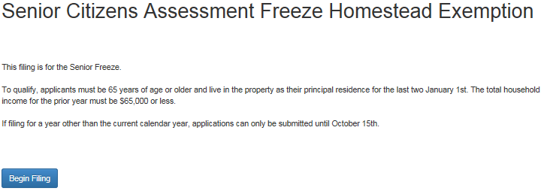
Click on Available Filings.
A list of all possible filings will display. Scroll down as there are several choices click on:
EX – Senior Citizens Assessment Freeze
Homestead Exemption
Click on Begin Filing.

Slide 4
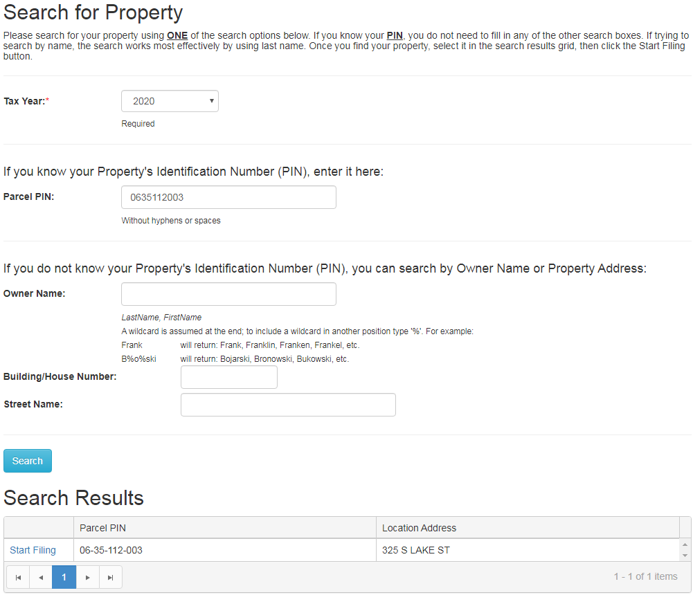
Make sure you select the 2020 Tax Year for which you are filing for the exemption.
If you know your Parcel PIN enter it without hyphens or spaces and click SEARCH.
Then click Start Filing
You can find your Parcel PIN on the Tax Bill or Blue Assessment Notice.
If you do not have your Parcel PIN, you can search by Owner Name or Property Address. Follow the instructions on the web page.
Still having trouble finding the PIN, contact us here at Fremont Township Assessor’s Office.
847-223-2846, M-F 8:30 to 3:30
Click the drop-down arrow to select the 2020 Tax Year.
Type PIN HERE
Click Search. If you entered a correct PIN, or searched a correct Name or Address it will show under
Search Results. Click Start Filing if your PIN and Address populate.
PIN with show here.
Address will show here.

Slide 5
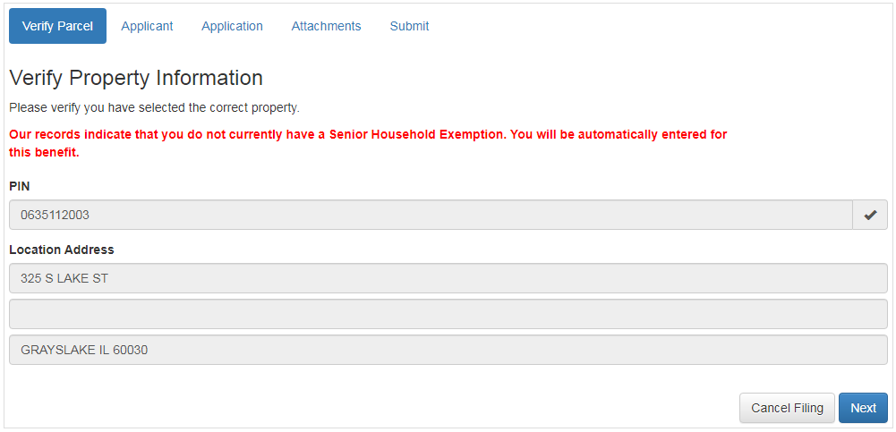
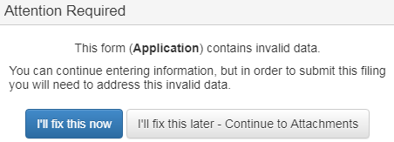
Your PIN number and Address will
populate, if everything looks good
click on NEXT.
If you see this statement, disregard it. It will have no impact
on your Assessment Freeze Application.
Your PIN number will show here.
Your address will show here.
If this error message appears at anytime while
filing out the form, Click on I’ll fix this now.
Any required information that is missing will
be highlighted.

Slide 6
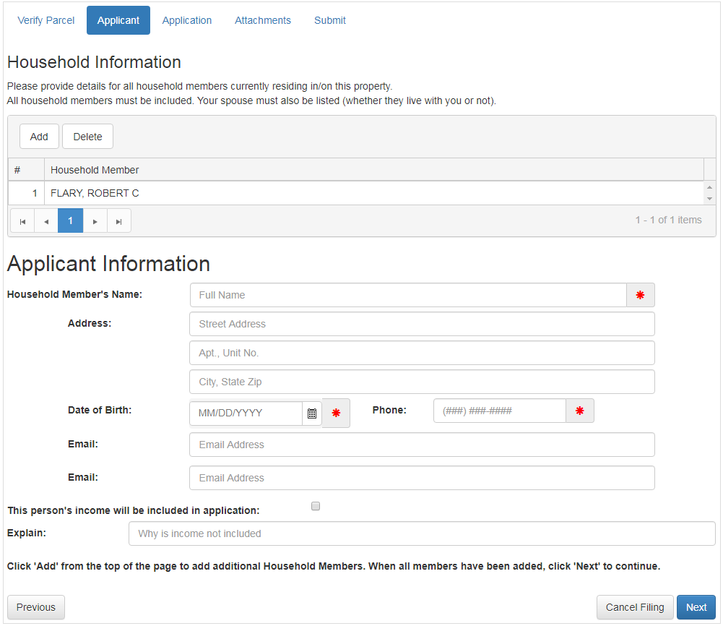
Household Information
Per the Assessment Freeze instructions, an applicant is required to add all household members and include all income for all persons residing at your residence. This would include a spouse or any other persons residing with you.
For the senior applicant
click on the Household member name
Enter the Date of Birth, Phone, Email
Mark the check box indicating “income will be included”
To add Household Members
click ADD
Enter the Household Member Name, Address, Date of Birth, Phone, Email
Mark the check box indicating “income will be included”
When all entries are complete click NEXT.
Your name and or other persons name listed on Deed to the House. Click on name who is filing for the Exemption.

Slide 7
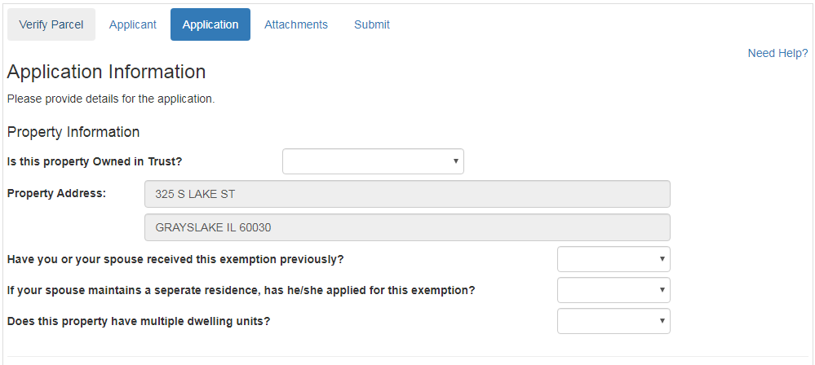
Click the drop-down arrow and select
Yes or No to answer Trust question.
Verify the property address is correct.
Using the drop-down arrows answer
the questions.
Continue to next page of this help
document.

Slide 8
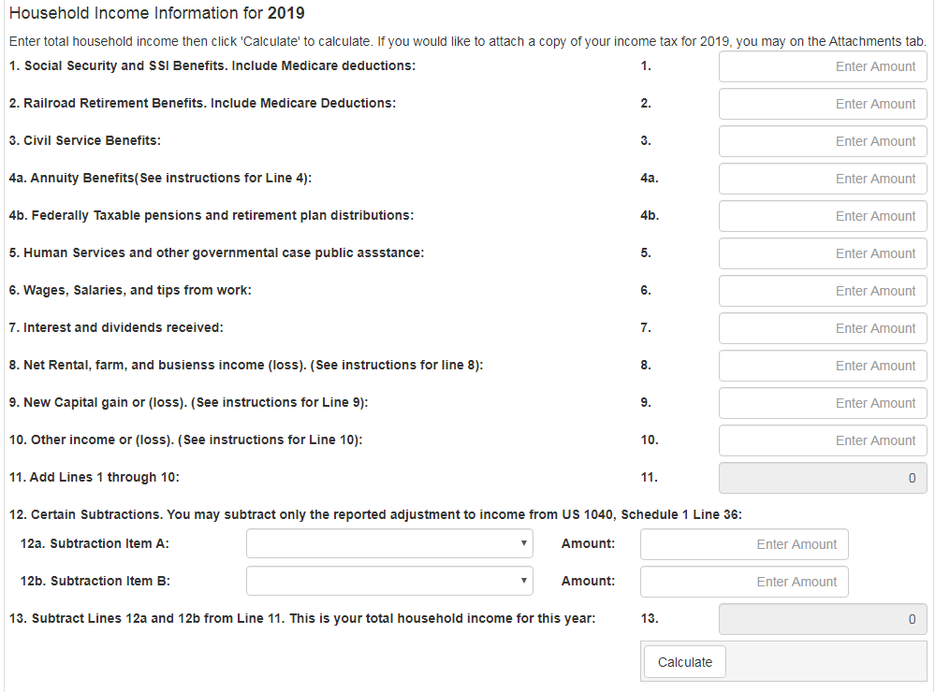
Using your Federal Form
1040 or 1040 SR, enter
income to the correct lines
on this form.
The references noted on this form are the lines from the income tax return
Amount from line 5a
Amount form line 4d
Amount from line 4a
Note #1
Add lines 2a,2b and 3b
from form 1040 or 1040SR
if you have amounts in
any or all these fields.
Amount from line 1
See Note # 1
Amount from line 6
When finished click CALCULATE

Slide 9
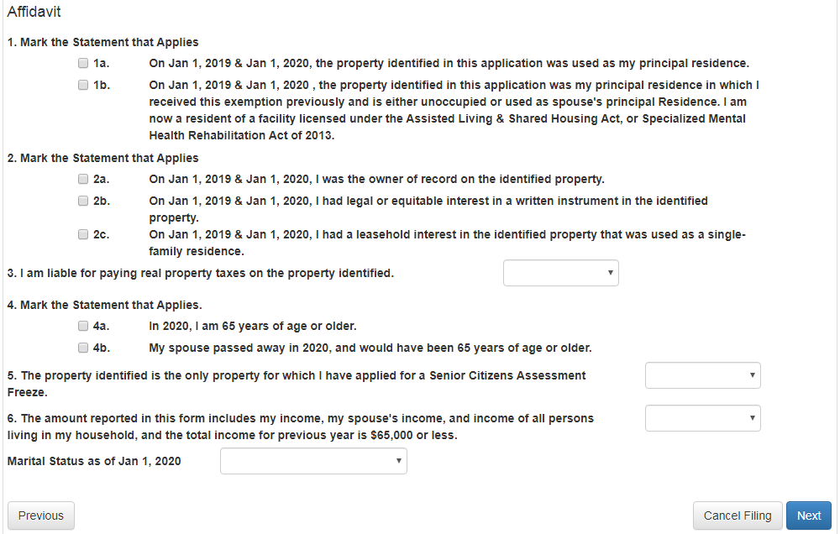
Choose the statement that best
applies to your situation by
either clicking on a box or using
the drop-down arrow.
For questions 1, 2, and 4
the most common answers are
1a, 2a, and 4a.
For questions 3, 5 and 6
Use the drop-down arrow to
select the answer that best
applies to your situation.
Click NEXT.

Slide 10
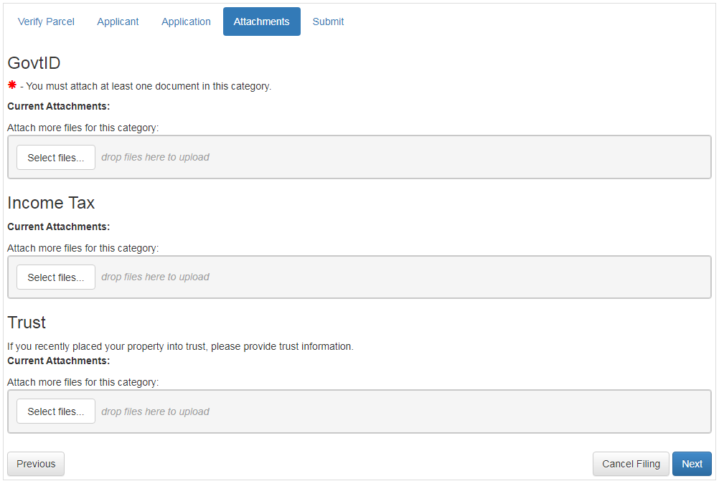
This is where you will need to scan or take a picture of your Drivers License or State ID and upload the file to the application.
When you click SELECT FILES, your computer will open showing all different drives where a file could be saved.
This will be different on all computers. You will need to know where your Drivers License or State ID has been saved
It is a best practice to attach a copy of your Federal form 1040 or 1040 SR.
You can follow the same procedure
as used for the Drivers License.
Click NEXT.

Slide 11
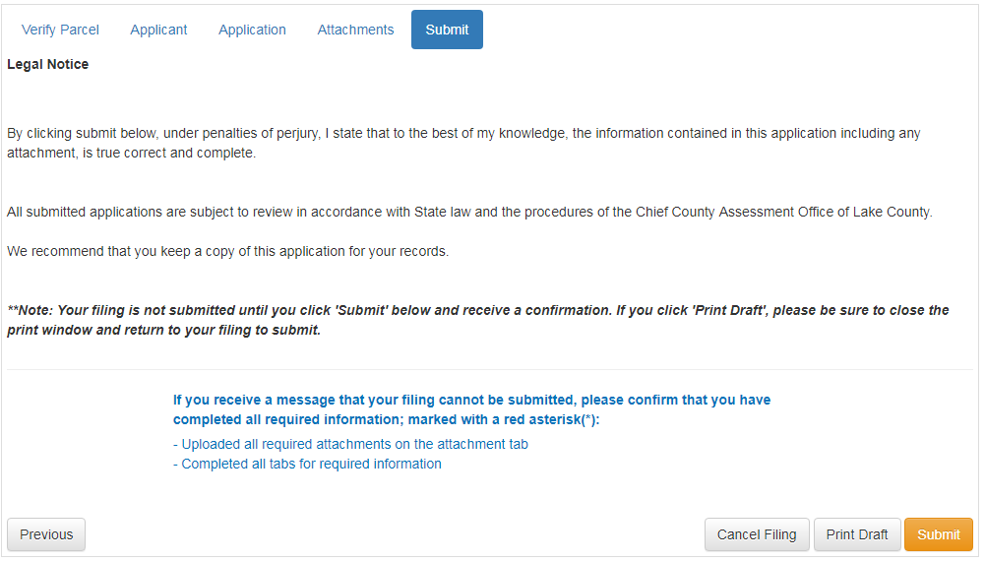
Click SUBMIT. A box will pop up asking if you really want to submit this application.
Click SUBMIT again.
A new box will pop up with a File ID number. It is your choice to copy this number as it will not show up on form if you print a copy.
Click OK on the File ID box and decide if you want to print a copy of the completed application or click DONE.
Check your email for confirmation of filing.

